Slide 1







Motorola Sales Dashboard Analysis
Power BI Sales Intelligence Tool

Slide 2

🧩 Project Overview
Interactive dashboard for Motorola's sales analysis
Tracks KPIs: sales, quantity, transactions, ratings
Enables data-driven decisions using real-time visuals

Slide 3
SALE
🏢 Business Context
SALE
Competitive smartphone market
SALE
Lack of real-time insights
Need for location, model & payment-wise performance tracking
SALE
SALE-SALE-SALE-SALE

Slide 4

🎯 Project Objectives
Visualize key sales metrics
Identify trends by city, model, time
Analyze customer satisfaction
Compare payment method performance
Enable dynamic filtering & drilldowns

Slide 5

👥 Target Users
Sales Managers – Performance tracking
Marketing Teams – Regional trends
Inventory Planners – Stock & demand forecasting
Executives – Strategic decision support

Slide 6


❗ Problems Solved
Objectives
No centralized sales dashboard
Poor visibility into city/model-wise performance
No customer feedback insights
Missed opportunities around peak sales periods
Unclear payment preferences

Slide 7
“
💡 Key Dashboard Features
KPI Cards
Sales Analysis
Product & Payment View
Total Sales
Total Quantity Sold
Total Transactions
Avg. Sales per Transaction
By City – Regional performance
By Month & Day – Seasonal trends
By Day Name – Weekly sales pattern
Sales by Mobile Model
Sales by Payment Method
Interactive Filters
Brand-Wise Table
Customer Insight
Customer Ratings – Product satisfaction
Month-wise & Category-wise drilldowns
Quantity & transactions by Motorola sub-brands
Someone famous
SALE-SALE-SALE-SALE

Slide 8

WO
📦 Data Snapshot
5,000+ records (CSV)
Fields: Date, City, Model, Rating,
Payment, Brand, etc.
Cleaned, structured, and anonymized

Slide 9
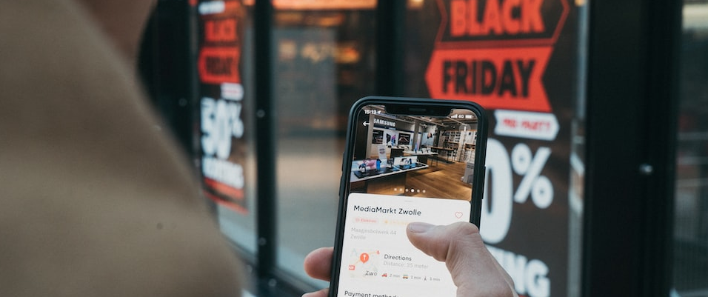
🛠 Tools & Tech Used
01
02
Power BI – Dashboarding
Power Query – Data cleaning
DAX – Custom metrics
Excel/CSV – Data source

Slide 10
🧪 Solution Approach
Cleaned data & standardized values
Star schema modeling
DAX measures for KPIs
Time intelligence for trends
Multiple visualization types for clarity

Slide 11
📈 Business Impact
Real-time insights for decision-makers
Better sales targeting by location/time
Product & service quality feedback
Improved campaign & inventory planning

Slide 12

📚 Skills & Learnings
Data Modeling & Power Query
Power BI UX/UI Design
DAX Measures & Time Intelligence
Business Intelligence Storytelling

Slide 13



🔚 Conclusion
Holistic sales visibility
Informed strategies via real-time visuals
Enhances planning, performance & customer focus
01
02
03

Slide 14
✅ Future Scope
1
AI/ML Sales Forecasting
2
Inventory-Level Dashboard
3
Customer Segmentation
4
Campaign Performance Metrics
5
Geo-Mapping for Regional Insights

Slide 15
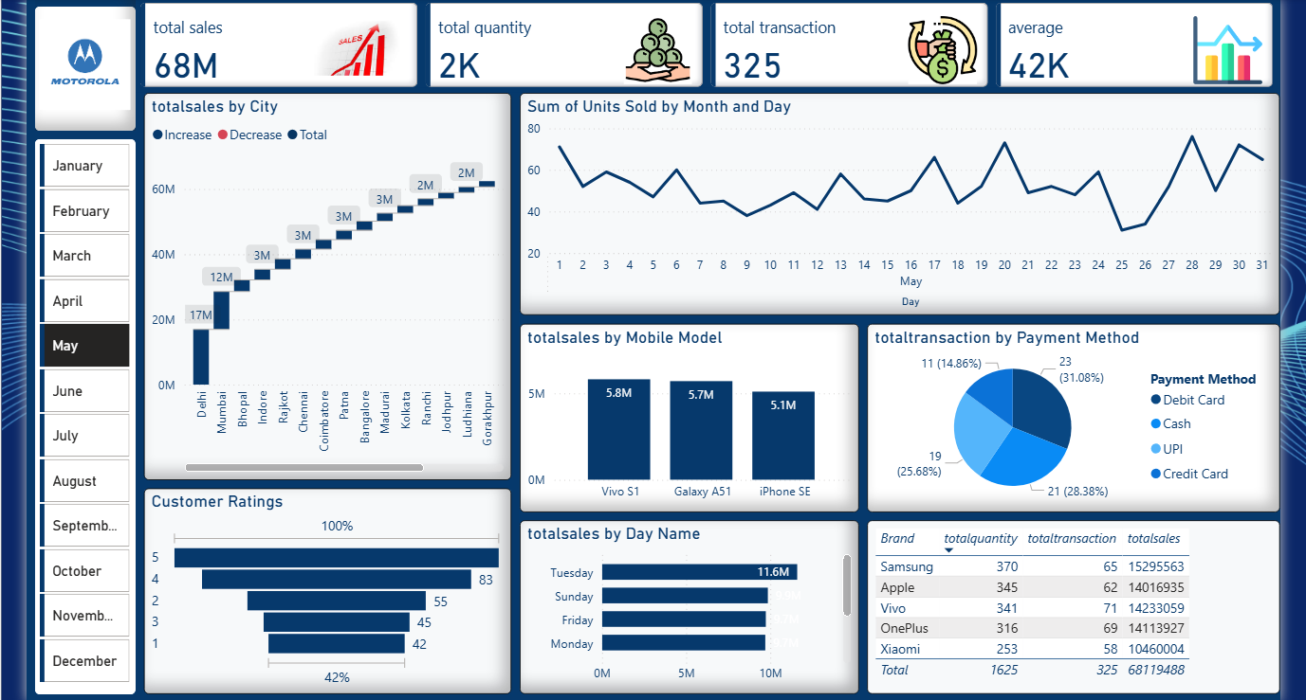
SALE
Final Dashbaord
SALE
SALE
SALE
SALE-SALE-SALE-SALE

Slide 16
SALE
Project
Overview
SALE
SALE
SALE
SALE-SALE-SALE-SALE

Slide 17
SALE
make it simple
SALE
THANKS FOR WATCHING
SALE
Thank you for your attention!
For feedback, improvements, or project collaboration:
SALE
SALE-SALE-SALE-SALE

